Slide 1
1010043316
Analysis and Design of Algorithms
Unit 2: Divide-and-Conquer
SEMESTER: 5

Slide 2
CHAPTER 3 TOPIC
What is divide and conquer?
Divide-and-Conquer Examples
General Divide-and-Conquer Recurrence
Merge Sort
Quick Sort
Binary Serarch
Large Integer Multiplication
Strassen Multiplication
2

Slide 3
What is divide and conquer?
The most-well known algorithm design strategy:
1. Divide instance of problem into two or more smaller instances
2.Solve smaller instances recursively
3.Obtain solution to original (larger) instance by combining these solutions
Distinction between divide and conquer and decrease and conquer is somewhat vague. Dec/con typically does not solve both subproblems.
3

Slide 4
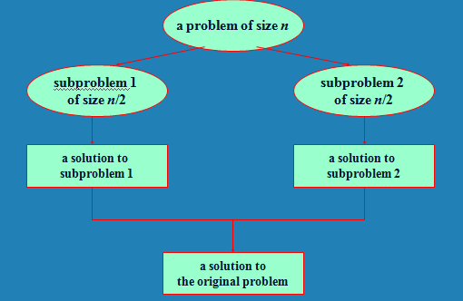
What is divide and conquer?
4

Slide 5
Divide-and-Conquer Examples
Sorting: mergesort and quicksort
Binary tree traversals
Multiplication of large integers
Matrix multiplication: Strassen’s algorithm
Closest-pair and convex-hull algorithms
Binary search: decrease-by-half (or degenerate divide&conq.)
5

Slide 6
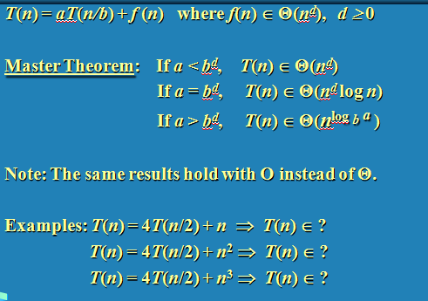
General Divide-and-Conquer Recurrence
6

Slide 7
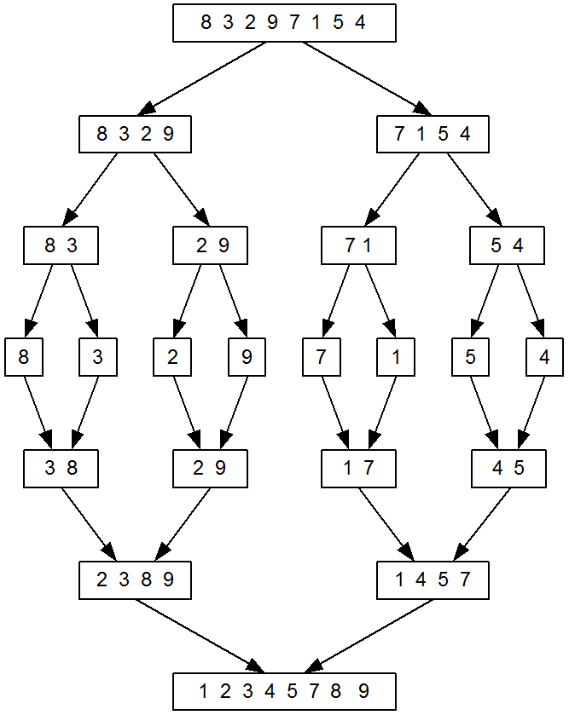
Merge Sort Example
7

Slide 8
Merge Sort
Split array A[0..n-1] in two about equal halves and make copies of each half in arrays B and C
Sort arrays B and C recursively
Merge sorted arrays B and C into array A as follows:
  Repeat the following until no elements remain in one of the arrays:
    compare the first elements in the remaining unprocessed portions of the arrays
    copy the smaller of the two into A, while incrementing the index indicating the unprocessed portion of that array
  Once all elements in one of the arrays are processed, copy the remaining unprocessed elements from the other array into A.
8

Slide 9
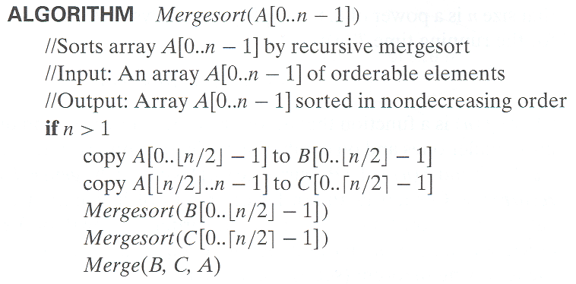
Pseudocode of Merge Sort
Thinking about recursive programs:
Assume recursive calls work and
ask does the whole program then work?
9

Slide 10
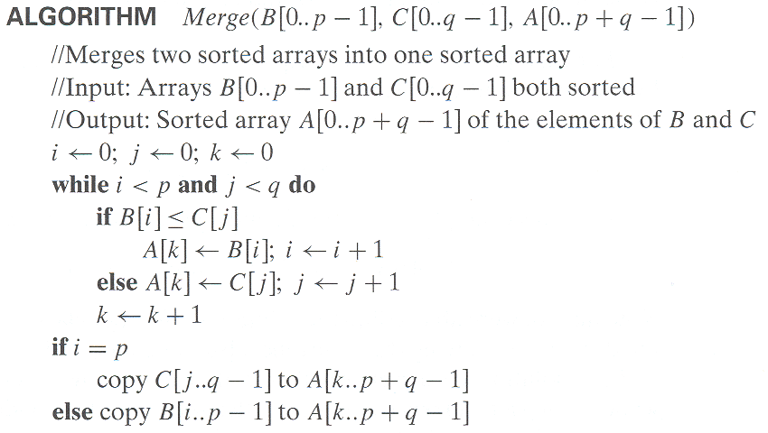
Pseudocode of Merge
10

Slide 11
Analysis of Merge Sort
All cases have same efficiency: Θ(n log n)
Number of comparisons in the worst case is close to theoretical minimum for comparison-based sorting:
  - Theoretical min: ⎡log₂ n!⎤ ≈ n log₂ n - 1.44n
Space requirement:
  Book’s algorithm: n + n Sum(1+1/2+1/4+…) = n + n Θ(2)= Θ(3n)
  Can be done Θ(2n) : Don’t copy in sort; just specify bounds, copy into extra array on merge, then copy back
    Any other space required?
  Can be implemented in place. How …
Can be implemented without recursion (bottom-up)
11

Slide 12
Quick Sort
Select a pivot (partitioning element) – here, the first element
Rearrange the list so that all the elements in the first s positions are smaller than or equal to the pivot and all the elements in the remaining n-s positions are larger than or equal to the pivot (see next slide for an algorithm)
Exchange the pivot with the last element in the first (i.e., ≤) subarray — the pivot is now in its final position
Sort the two subarrays recursively
p
A[i]≤p
A[i]≥p
12

Slide 13
Quick Sort Algorithm
QS (A, l, r)
if l < r then
s = partition (A, l, r)
QS (A, l , s-1)
QS (A, s+1, r )
Ask later: What if we skip final swap and
use simpler bounds for first recursive call?
13

Slide 14
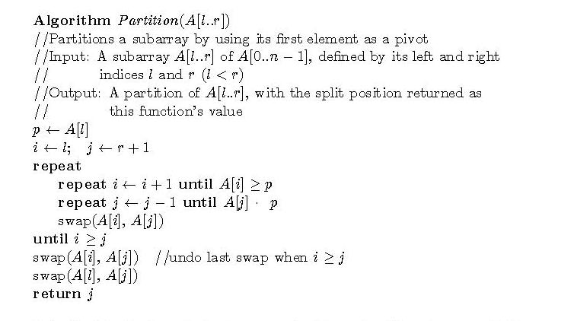
Quick Sort Partition Algorithm
14

Slide 15
Analysis of Quick Sort
Recurrences:
Best case: T(n) = T(n/2) + Θ (n)
Worst case: T(n) = T(n-1) + Θ (n)
Average case:
Performance:
Best case: split in the middle — Θ(n log n)
Worst case: sorted array! — Θ(n²)
Average case: random arrays — Θ(n log n)
15

Slide 16
Analysis of Quick Sort
Problems:
  Duplicate elements
Improvements:
  better pivot selection: median of three partitioning
  switch to insertion sort on small sub-arrays
  elimination of recursion – How?
  These combine to 20-25% improvement
Improvements: Dual Pivot
Method of choice for internal sorting of large files (n ≥ 10000)
16

Slide 17
Binary Search
Let ai, 1 ≤ i ≤ n be a list of elements that are sorted in non-decreasing order. The problem is to find whether a given element x is present in the list or not. If x is present we have to determine a value j (element’s position) such that aj=x. If x is not in the list, then j is set to zero.
Step 1: Pick an index q in the middle range [i, l] i.e. q= [(n + 1)/2] and compare x with aq.
Step 2: if x = aq i.e key element is equal to mid element, the problem is immediately solved.
Step 3: if x <aqin this case x has to be searched for only in the sub-list ai, ai+1, ……, aq- Therefore, problem reduces to (q-i, ai…aq-1, x).
Step 4: if x >aq,x has to be searched for only in the sub-list aq+1, ...,., al . Therefore problem reduces to (l-i, aq+1…al, x).
17

Slide 18
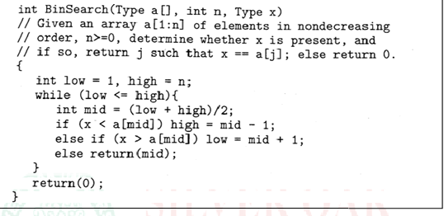
Iterative Binary Search
18

Slide 19
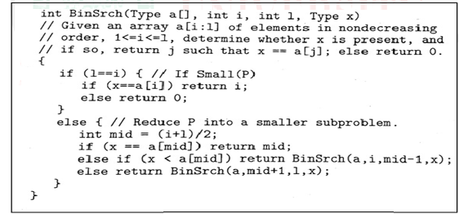
Recursive Binary Search
19

Slide 20
Analysis of Binary Search
Best case –Θ(1) In the best case, the key is the middle in the array. A constant number of comparisons (actually just 1) are required.
Worst case - Θ(log2 n) In the worst case, the key does not exist in the array at all. Through each recursion or iteration of Binary Search, the size of the admissible range is halved. This halving can be done ceiling(log2n ) times. Thus, [ log2 n ] comparisons are required.
Average case - Θ (log2n) To find the average case, take the sum of the product of number of comparisons required to find each element and the probability of searching for that element. To simplify the analysis, assume that no item which is not in array will be searched for, and that the probabilities of searching for each element are uniform.
20

Slide 21
Multiplication of Large Integers
Consider the problem of multiplying two (large) n-digit integers represented by arrays of their digits such as:
A = 12345678901357986429 B = 87654321284820912836
The grade-school algorithm:
a₁ a₂ … a_{n}
b₁ b₂ … b_{n}
(d₁₀) d₁₁d₁₂ … d_{1n}
(d₂₀) d₂₁d₂₂ … d_{2n}
… … … … … … …
(d_{n0}) d_{n1}d_{n2} … d_{nn}
Efficiency: n² one-digit multiplications
21

Slide 22
Example of Multiplication of Large Integers
A small example: A * B where A = 2135 and B = 4014
A = (21·10² + 35), B = (40 ·10² + 14)
So, A * B = (21 ·10² + 35) * (40 ·10² + 14)
= 21 * 40 ·10⁴ + (21 * 14 + 35 * 40) ·10² + 35 * 14
In general, if A = A₁A₂ and B = B₁B₂ (where A and B are n-digit,
and A₁, A₂, B₁, B₂ are n / 2-digit numbers),
A * B = A₁ * B₁·10^{n} + (A₁ * B₂ + A₂ * B₁) ·10^{n/2} + A₂ * B₂
Recurrence for the number of one-digit multiplications M(n):
M(n) = 4M(n/2), M(1) = 1
Solution: M(n) = n²
22

Slide 23
Second Divide-and-Conquer Algorithm
A * B = A₁ * B₁·10^{n} + (A₁ * B₂ + A₂ * B₁) ·10^{n/2} + A₂ * B₂
The idea is to decrease the number of multiplications from 4 to 3:
(A₁ + A₂ ) * (B₁ + B₂ ) = A₁ * B₁ + (A₁ * B₂ + A₂ * B₁) + A₂ * B_{2,}
I.e., (A₁ * B₂ + A₂ * B₁) = (A₁ + A₂ ) * (B₁ + B₂ ) - A₁ * B₁ - A₂ * B_{2,}
which requires only 3 multiplications at the expense of (4-1=3) extra additions and subtractions (2 adds and 2 subs – 1 add)
Recurrence for the number of multiplications M(n):
M(n) = 3M(n/2), M(1) = 1
Solution: M(n) = 3^{log 2n} = n^{log 23} ≈ n^{1.585}
23

Slide 24
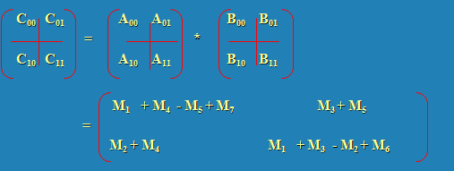
Strassen’s Matrix Multiplication
Strassen observed [1969] that the product of two matrices can be computed as follows:
Example: M₂ + M₄ = (A₁₀ + A₁₁) * B₀₀ + A₁₁ * (B₁₀ - B₀₀)
= A₁₀B₀₀ + A₁₁B₁₀
24

Slide 25
Formulas for Strassen’s Algorithm
M₁ = (A₀₀ + A₁₁) * (B₀₀ + B₁₁)
M₂ = (A₁₀ + A₁₁) * B₀₀
M₃ = A₀₀ * (B₀₁ - B₁₁)
M₄ = A₁₁ * (B₁₀ - B₀₀)
M₅ = (A₀₀ + A₀₁) * B₁₁
M₆ = (A₁₀ - A₀₀) * (B₀₀ + B₀₁)
M₇ = (A₀₁ - A₁₁) * (B₁₀ + B₁₁)
25

Slide 26
Analysis of Strassen’s Algorithm
If n is not a power of 2, matrices can be padded with zeros.
Number of multiplications:
M(n) = 7M(n/2), M(1) = 1
Solution: M(n) = 7^{log 2n} = n^{log 27} ≈ n^{2.807} vs. n³ of brute-force alg.
Algorithms with better asymptotic efficiency are known but they are even more complex.
26

Slide 27
Key Points
What is divide and conquer?
Divide-and-Conquer Examples
General Divide-and-Conquer Recurrence
Merge Sort
Quick Sort
Binary Serarch
Large Integer Multiplication
Strassen Multiplication
27
Notes:
27

